Slide 1
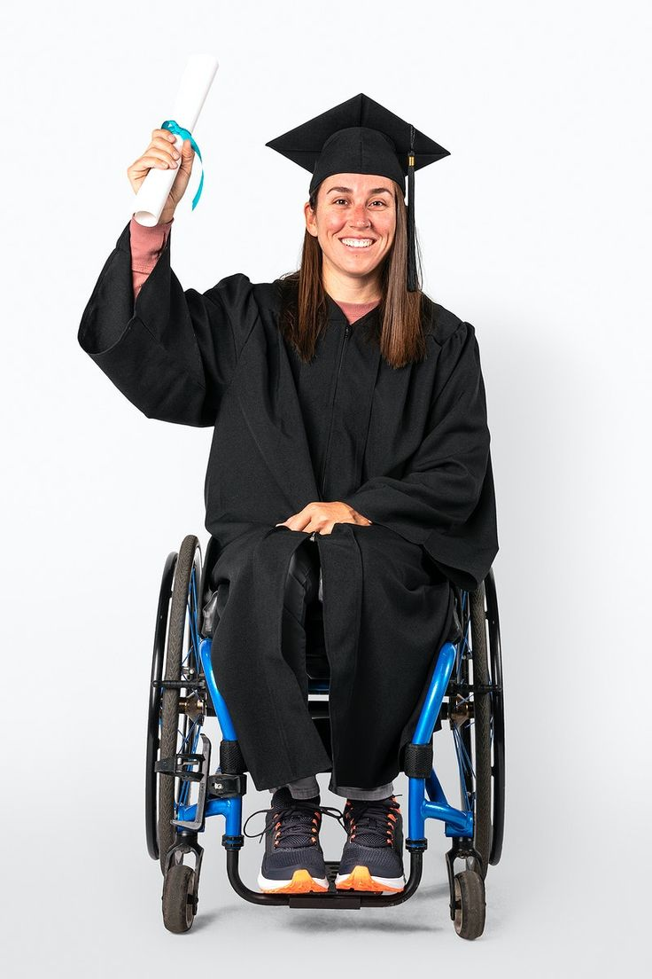
Ai in Special Education for Differently Abled Students
Team Name :- Ctrl Alt Defeat
Priyanshu Kesharwani, Anjali Rajput and Anushka Mewada
from SISTec collage Gandhinagar Bhopal M.P

Slide 2
The Problem
1B+
0
∞
People with Disabilities
Complete Solutions
Potential
Over 1 billion people worldwide live with some form of disability
Education platforms often lack accessibility for diverse needs
Existing solutions are fragmented, inconsistent, or non-adaptive

Slide 3

Why It Matters
A Right, Not a Feature
Inclusive education is fundamental to human dignity
Enabling Opportunity
Equal access creates independence and possibilities
Scalable Accessibility
AI enables personalization at scale

Slide 4

Our Solution
AI-Powered Platform
Centralized & Personalized
Beyond Compliance
Tailored specifically for users with various disabilities
Focus on usability and experience, not just meeting minimum standards
One platform that adapts to individual accessibility needs

Slide 5



Approach & Methodology
User-First Onboarding
AI Modules
Adaptive Learning
Based on specific disability needs
Speech, vision, and behavioral AI integration
Continuous improvement through user feedback

Slide 6





Key Features
Audio Study Materials
Eye & Facial Expression Input
For visually impaired users
For speech/mobility impaired users
Sign Language Translation
Accessible Interface
For hearing impaired users
User-friendly design for all abilities
Text-to-Speech
For reading/writing difficulties

Slide 7

User Flow
1
Sign Up
Select accessibility needs
2
Access Dashboard
View relevant materials
3
Engage AI Tools
Audio, sign language, facial cues
4
Track Progress
Receive personalized feedback

Slide 8
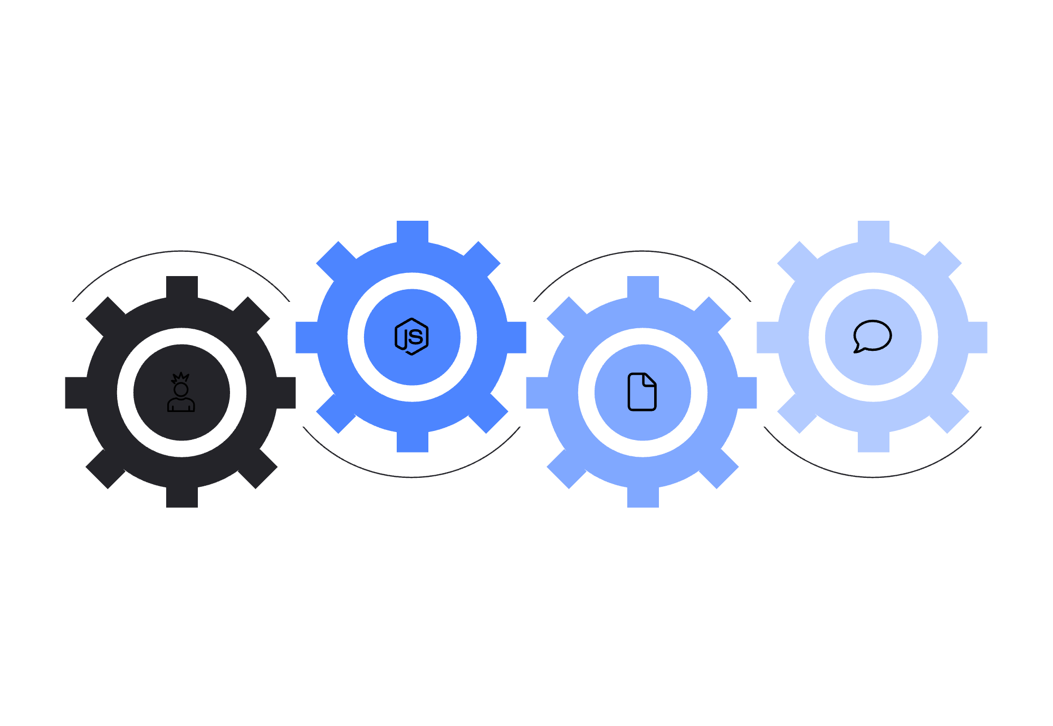




Technical Architecture
Tech Stack
Backend
AI Services
Frontend: React
Node.js + Express API and logic
TensorFlow and Google Cloud APIs
Backend: Node.js + Express
Database: MongoDB
AI: Google Cloud TTS, Vision APIs, TensorFlow/OpenCV
Frontend
Database
React app handling UI and requests
MongoDB stores application data

Slide 9
Expected Outcomes
Inclusive Education
Empowerment
A platform that truly works for all learners regardless of disability
Individuals with disabilities gain independence and confidence
Increased Engagement
Scalable Model
Higher participation in digital education opportunities
Framework for future integrations and expansions

Slide 10
Thank You
"Accessible learning is not optional. It's essential."

